Slide 1
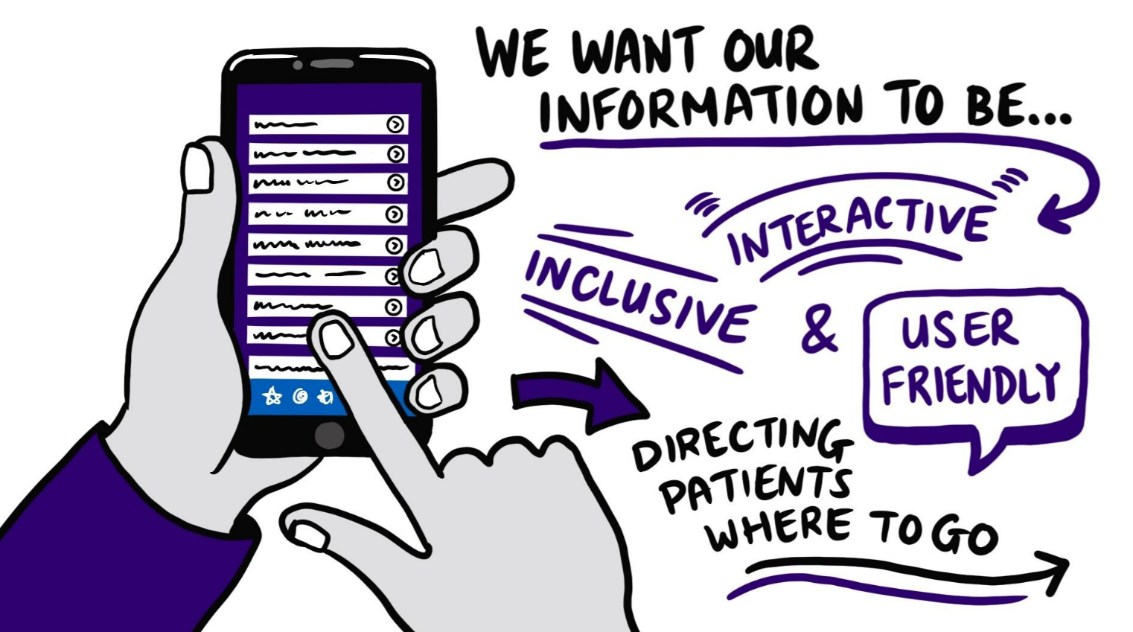
‘My Transfusion’ patient app
For adult patients receiving transfusion and their carers/relatives
Covers the transfusion journey, transfusion risks, benefits and alternatives for patients
Based on current national guidelines
Created with insights from patients and healthcare professionals

Slide 2
A short video is now available to promote the app
Here is the link for the short video on You Tube:
https://www.youtube.com/watch?v=M0OLiAa1fHI

Slide 3
A short video is now available to promote the app

Slide 4
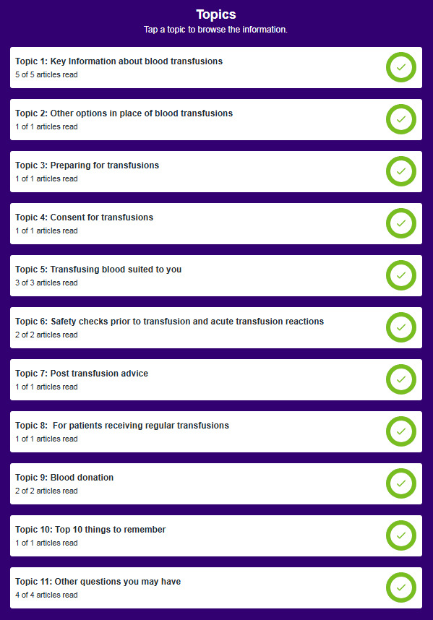
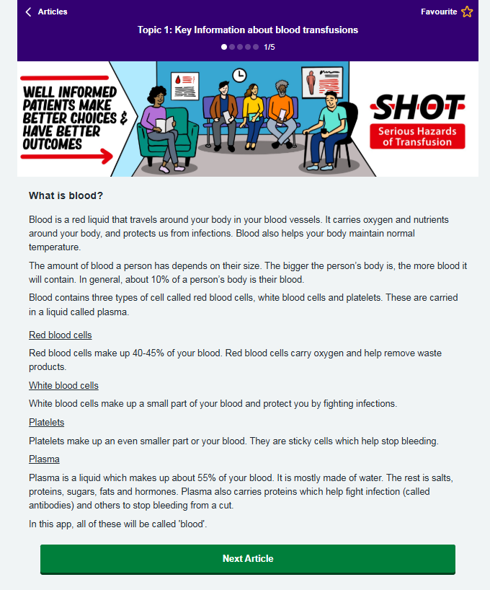
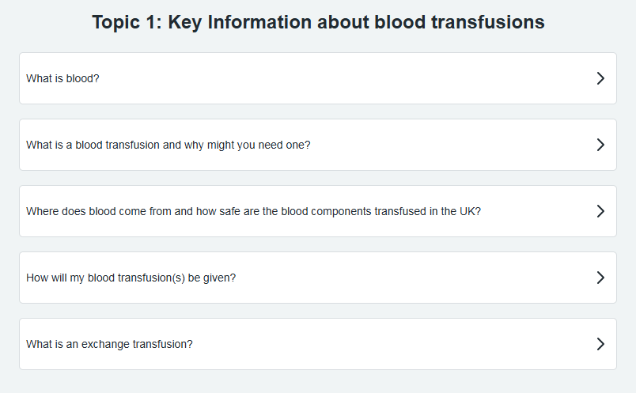
Topics

Slide 5
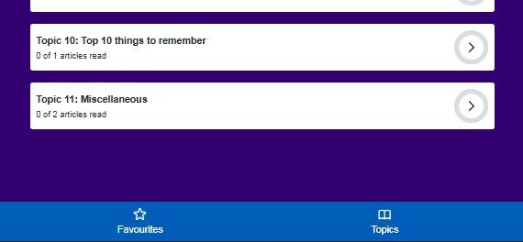
Favourites

Slide 6
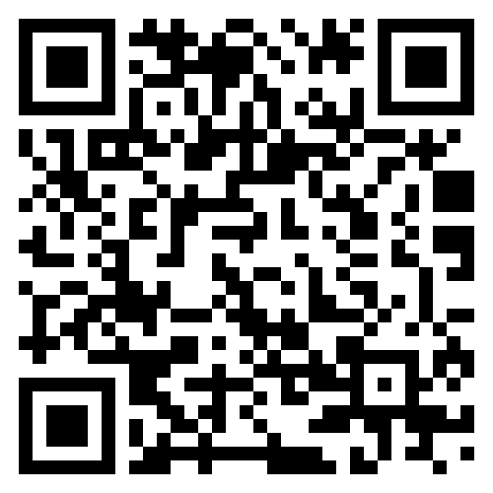
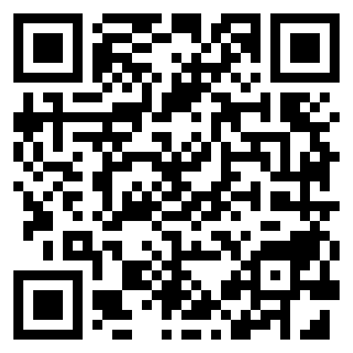
Download and view
Or view web browser version: https://www.mytransfusion.co.uk/

Slide 7
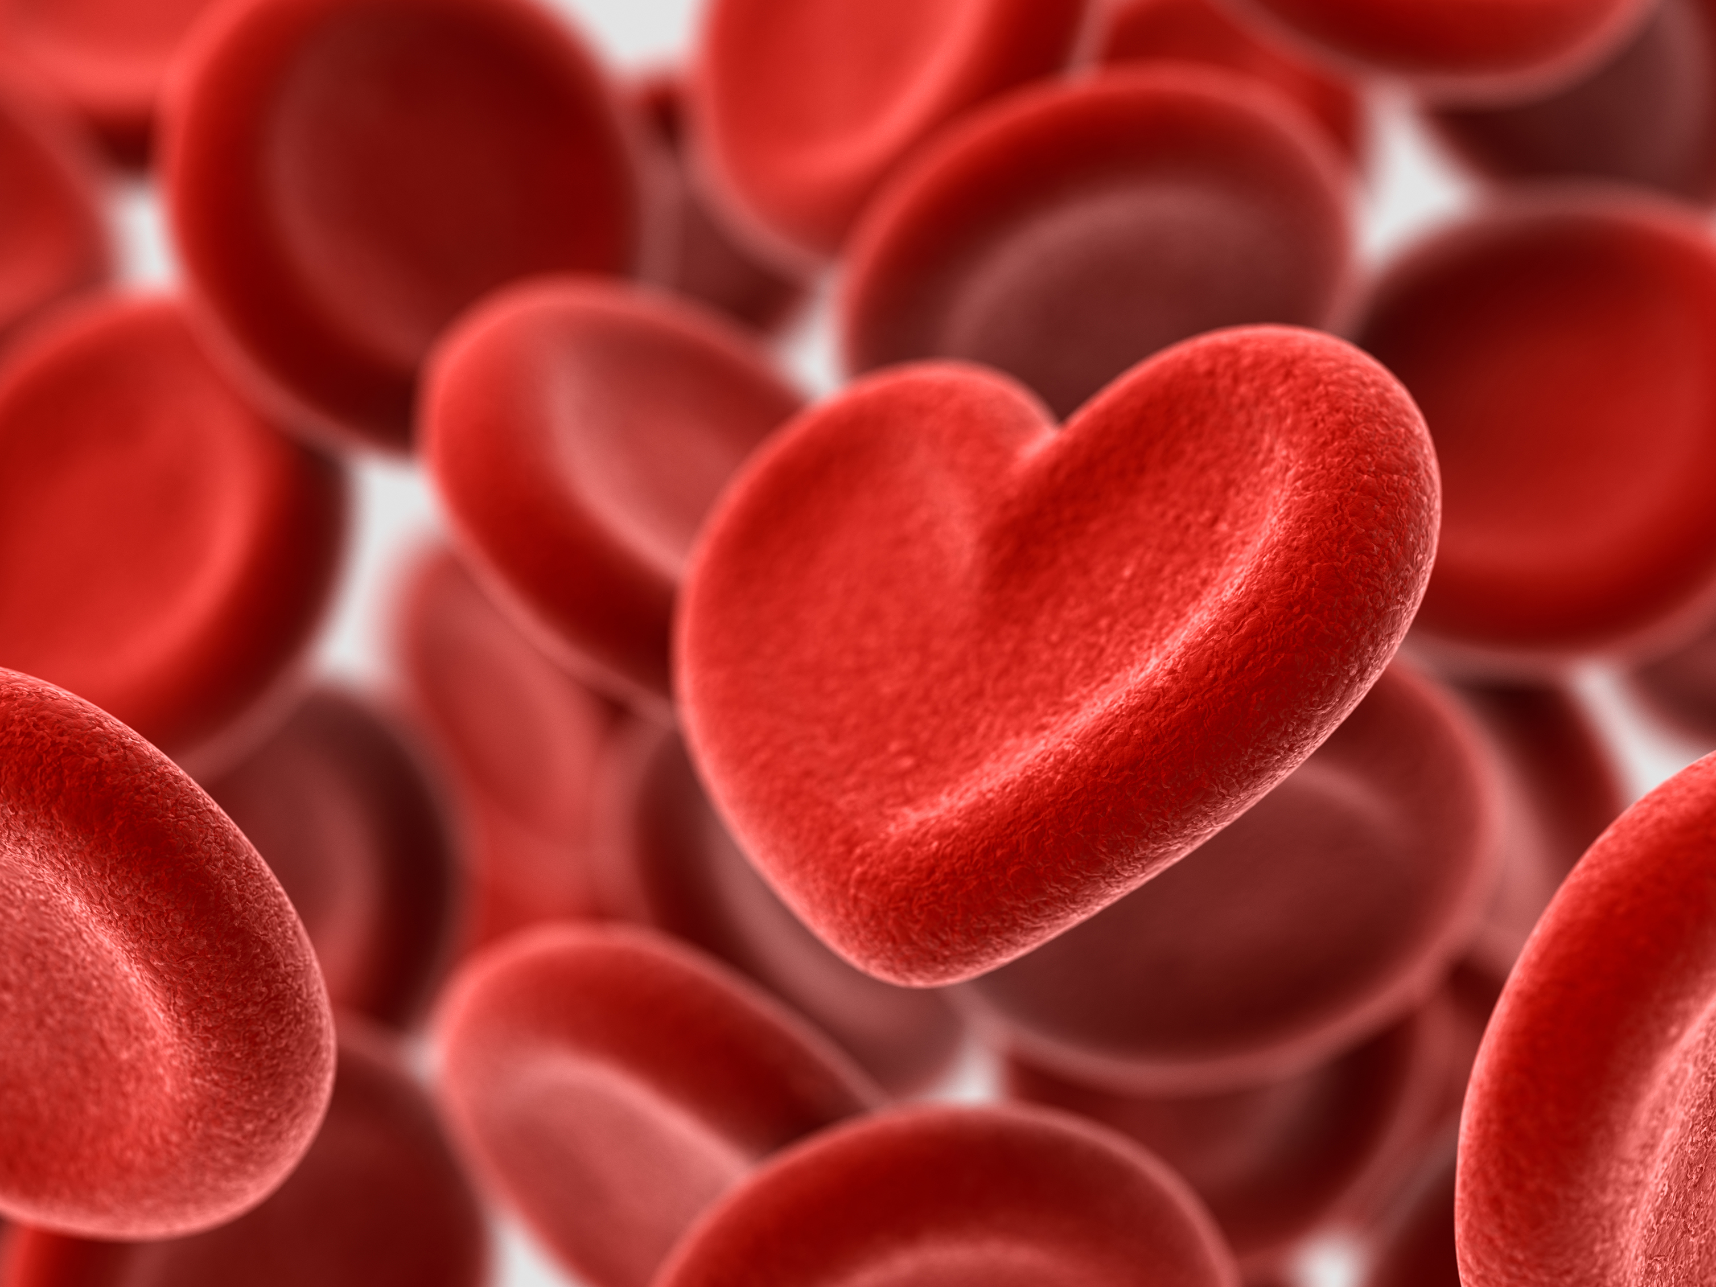
Acknowledgements
SHOT would like to extend our sincere gratitude to all who contributed to the creation of the My Transfusion app.
In particular, we would like to thank the patient representatives who have shared their insights and experiences.
Notes:
All involved especially patients

